Slide 1
LRP_MB update
22/July/2024
LRP plot update (both SL and RL) (channel relocate FC34 C34+-)
MB without baseline\
Next step: SSVEP and EMG (find decision commit time)

Slide 2
LRP analysis
For SL, 0 is evidence on; colour bar limit [-30-30]
For RL, 0 is trail end, app. Respond time is -233ms; colour bar limit [-8 8]

Slide 3
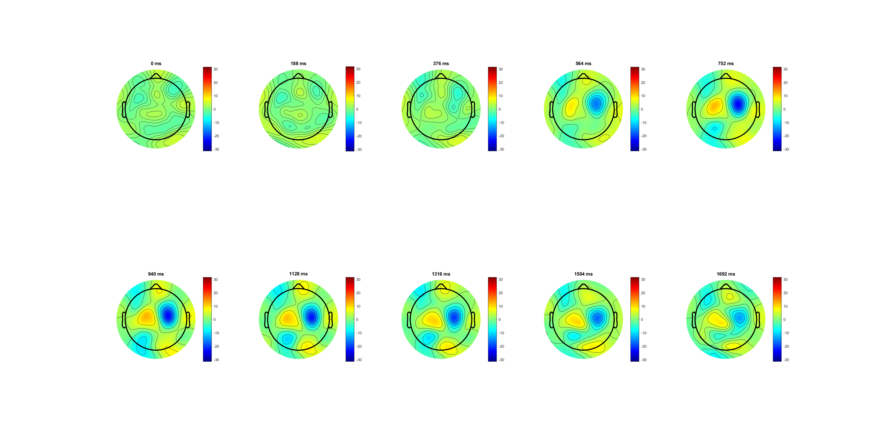
Correct
participant response
SL, 0 is evidence on

Slide 4
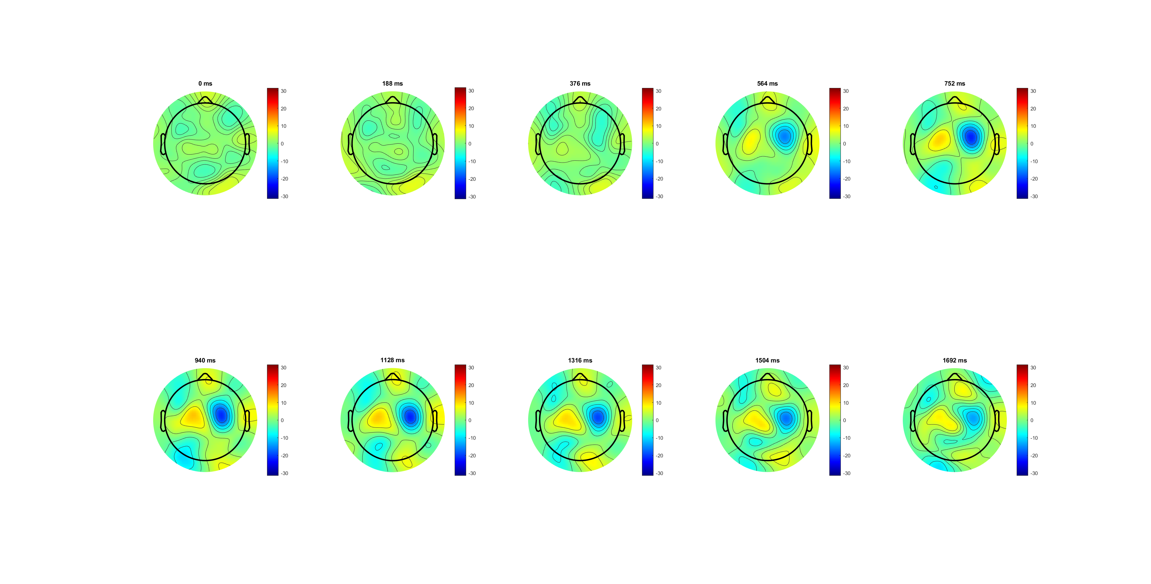
Wrong
participant response
SL, 0 is evidence on
Notes:
左减右，500秒左右出现了不对称
只要动了手不管正确错误都有
正确似乎颜色更深
位置靠近FC34

Slide 5
C34
FC34
participant response
SL, 0 is evidence on
Notes:
FC 34更清晰，right -wrong
显示在evidence on 后出现差异
Correct slope 更大，反超wrong且amplitude更高

Slide 6
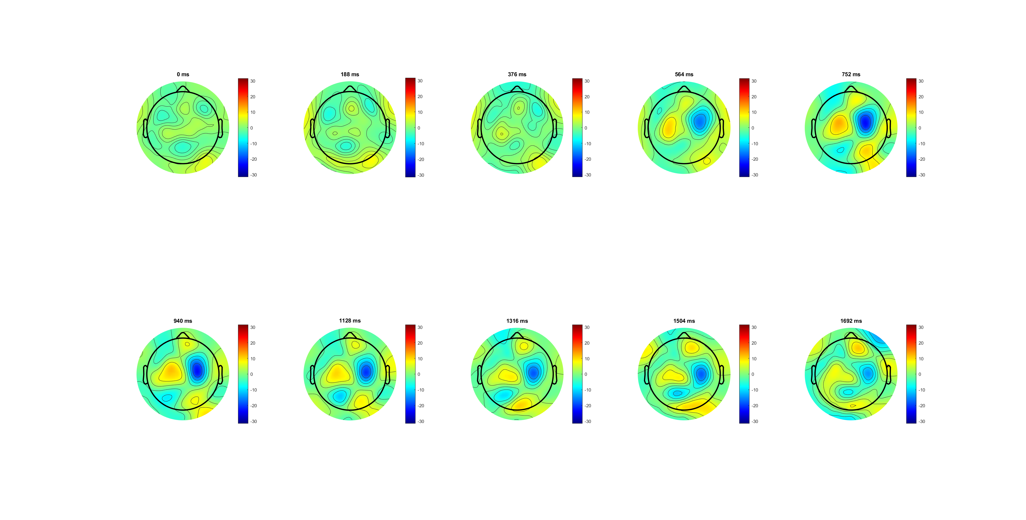
High 0.14
participant response
SL, 0 is evidence on

Slide 7
Low 0.07
participant response
SL, 0 is evidence on
Notes:
高数值高且peak早，
低peak晚且持续久
FC34更清晰

Slide 8
C34
FC34
participant response
SL, 0 is evidence on
Notes:
high斜率更大且到达peak更高

Slide 9
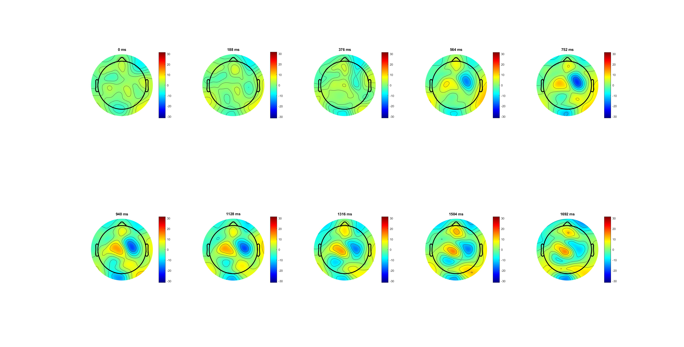
FDI
participant response
SL, 0 is evidence on

Slide 10
BCP
participant response
SL, 0 is evidence on

Slide 11
FC34
FC34 (correct)
participant response
SL, 0 is evidence on
Notes:
BCP LRP

Slide 12
RL
For SL, 0 is evidence on; colour bar limit [-30-30]
For RL, 0 is trail end, app. Respond time is -233ms; colour bar limit [-8 8]

Slide 13
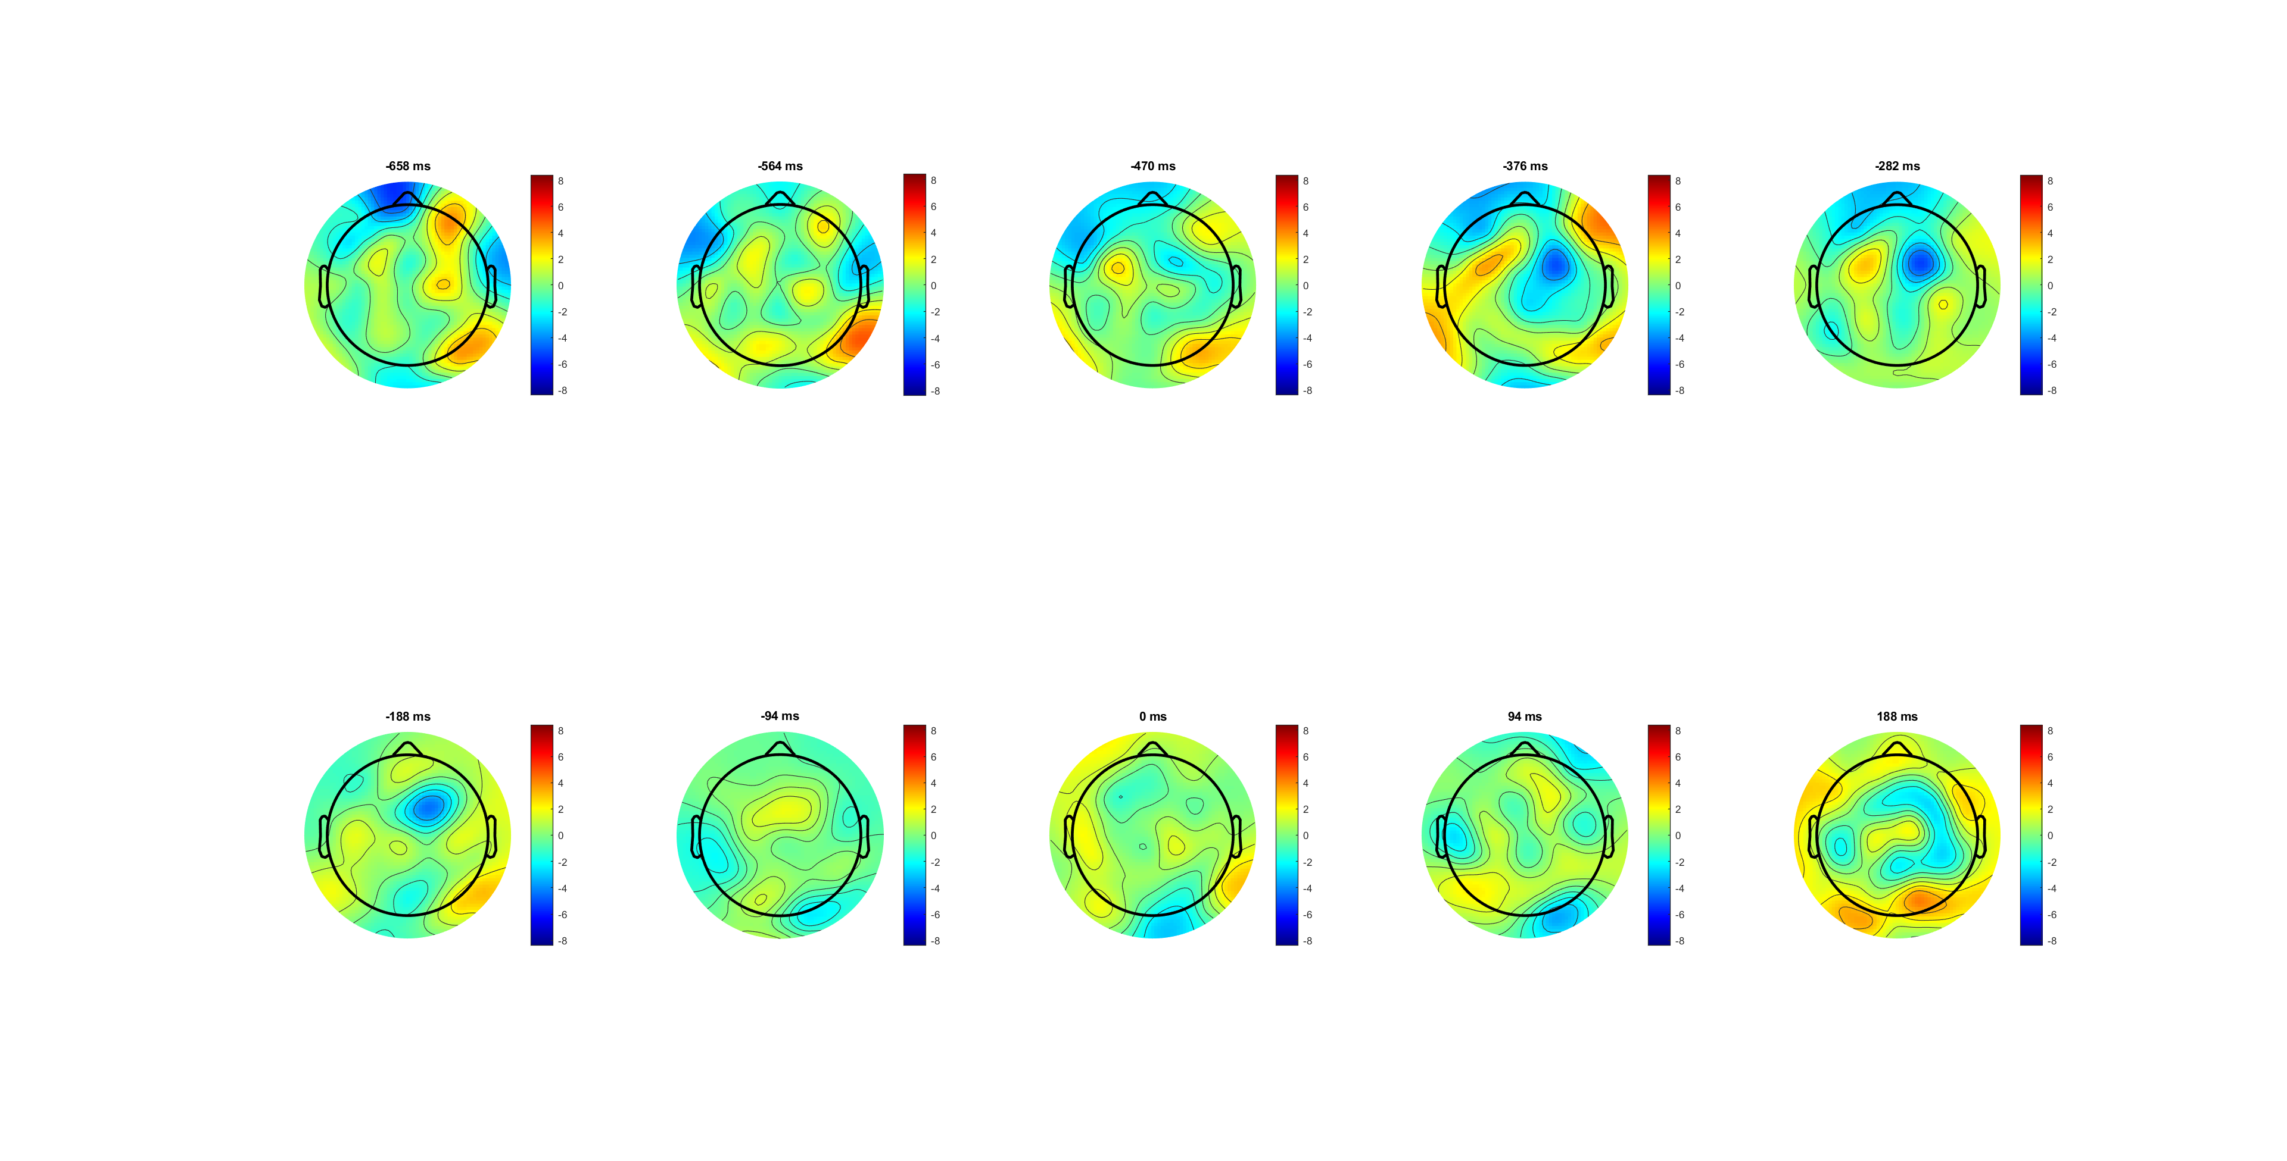
Correct
participant response

Slide 14
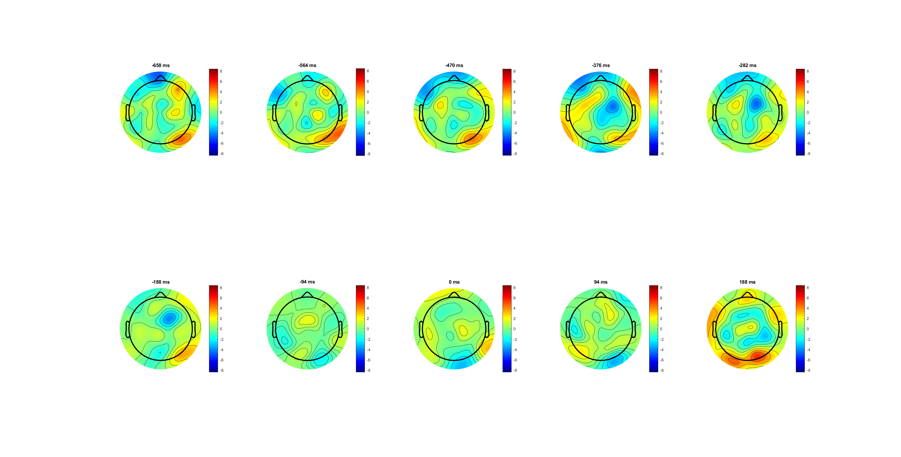
wrong
participant response

Slide 16
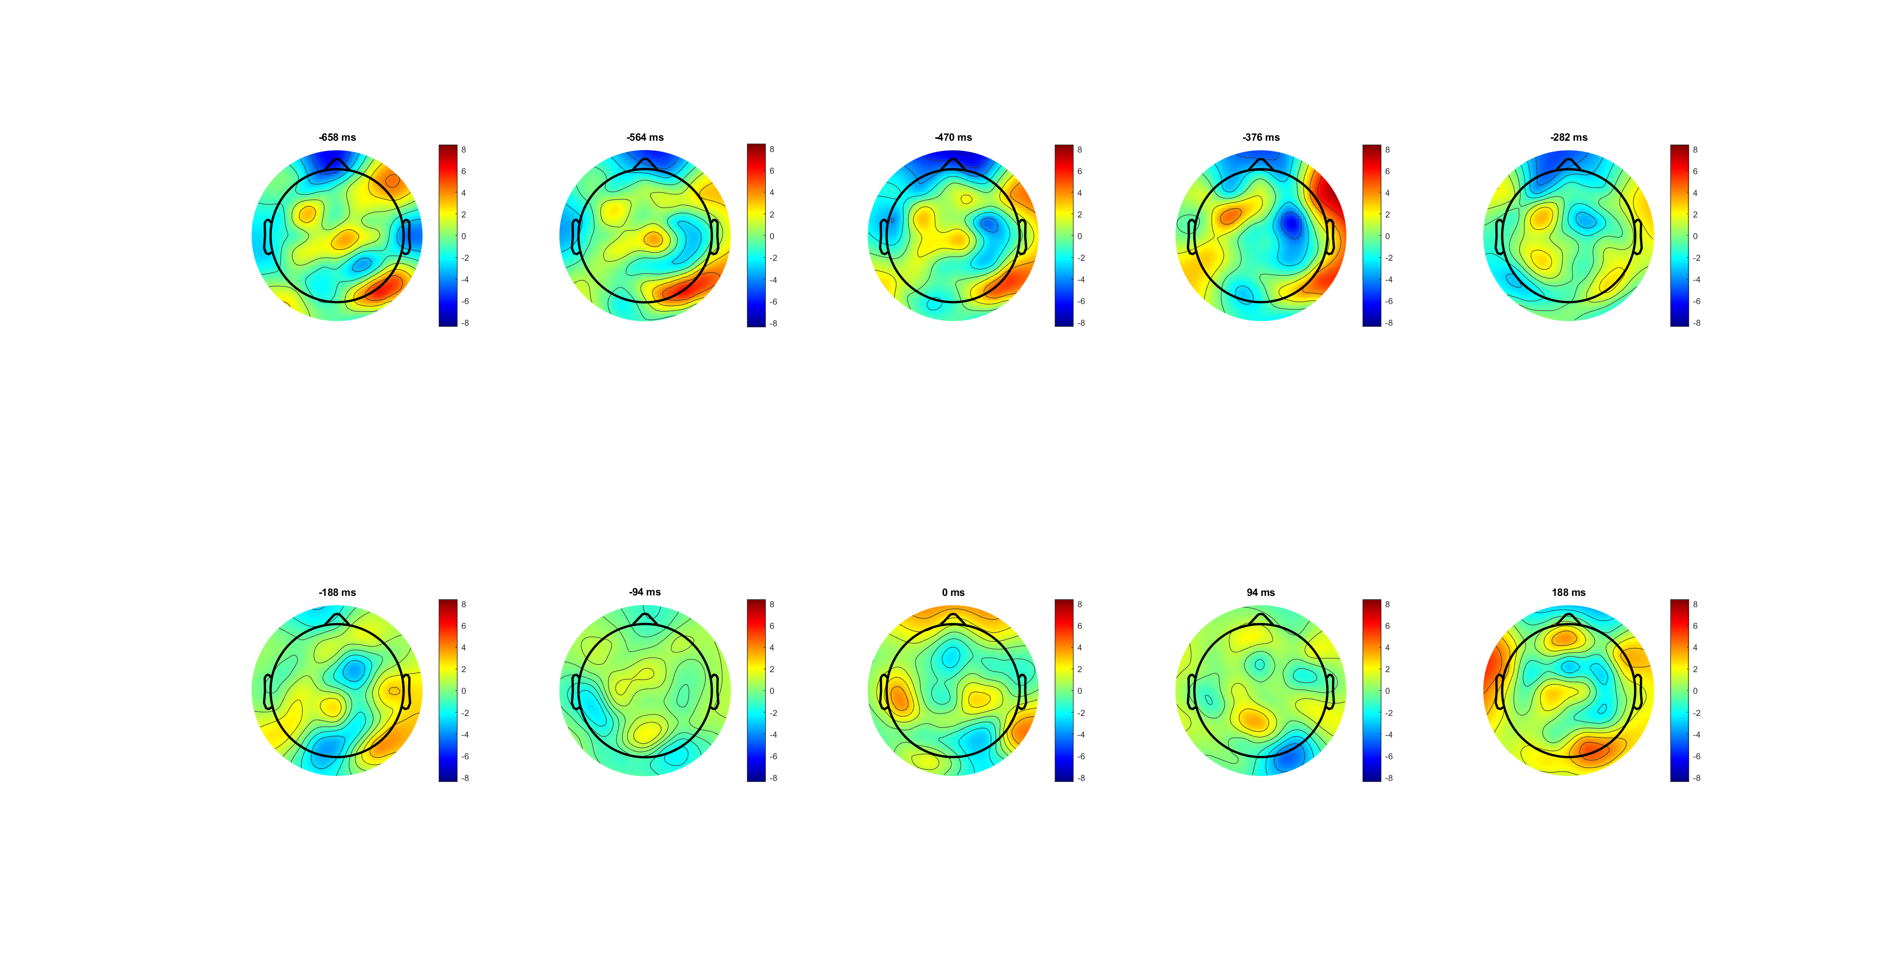
High 0.14
participant response

Slide 17
Low 0.07
participant response

Slide 18
participant response

Slide 19
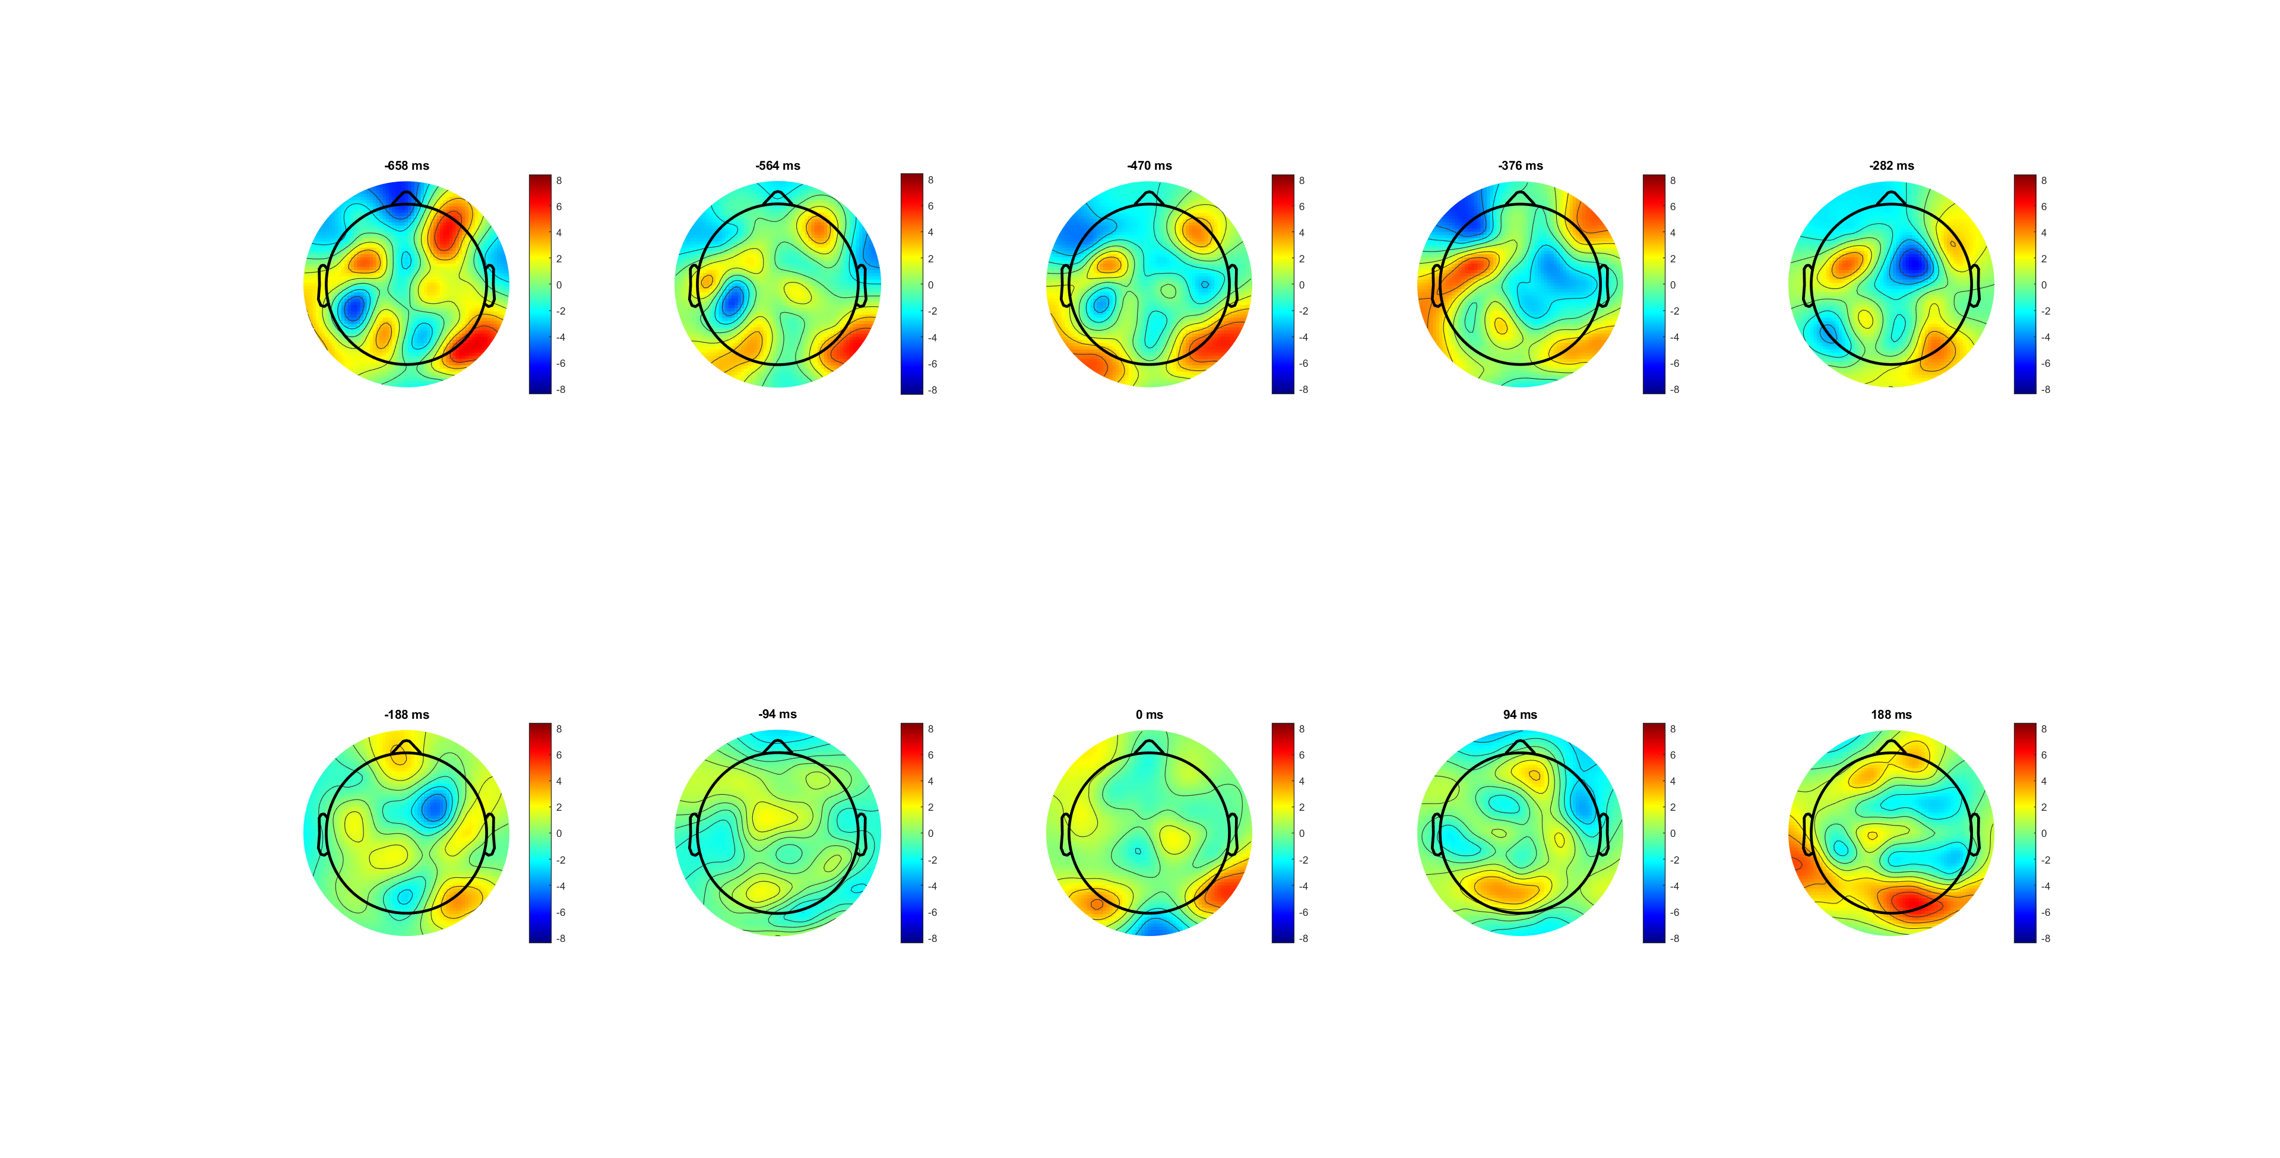
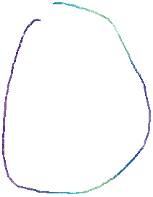
FDI correct
participant response

Slide 20

BCP correct
participant response

Slide 21
participant response

Slide 22
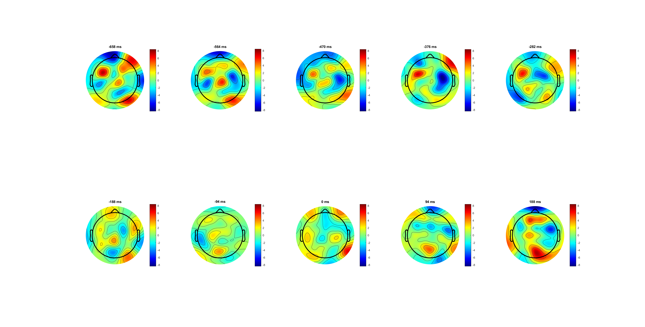

FDI correct high
participant response

Slide 23
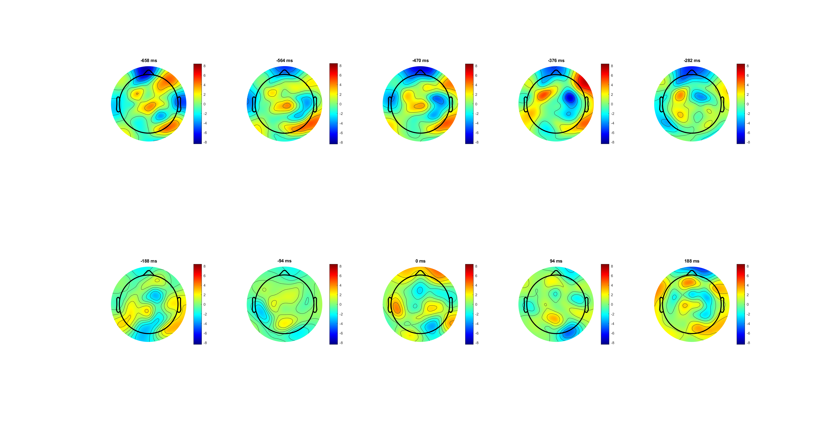

BCP correct high
participant response

Slide 24
participant response

